Slide 1
Using the Set Operators
Copyright © 2009, Oracle. All rights reserved.

Slide 2
Objectives
After completing this lesson, you should be able to do the following:
Describe set operators
Use a set operator to combine multiple queries into a single query
Control the order of rows returned
8 - 2

Slide 3
Lesson Agenda
Set Operators: Types and guidelines
Tables used in this lesson
UNION and UNION ALL operator
INTERSECT operator
MINUS operator
Matching the SELECT statements
Using the ORDER BY clause in set operations
8 - 3

Slide 4
Set Operators
A
B
A B
UNION/UNION ALL
A
B
INTERSECT
A
B
MINUS
8 - 4

Slide 5
Set Operator Guidelines
The expressions in the SELECT lists must match in number.
The data type of each column in the second query must match the data type of its corresponding column in the first query.
Parentheses can be used to alter the sequence of execution.
ORDER BY clause can appear only at the very end of the statement.
8 - 5

Slide 6
Oracle Server and Set Operators
Duplicate rows are automatically eliminated except in
UNION ALL.
Column names from the first query appear in the result.
The output is sorted in ascending order by default except in UNION ALL.
8 - 6

Slide 7
Lesson Agenda
Set Operators: Types and guidelines
Tables used in this lesson
UNION and UNION ALL operator
INTERSECT operator
MINUS operator
Matching the SELECT statements
Using the ORDER BY clause in set operations
8 - 7

Slide 8
Tables Used in This Lesson
The tables used in this lesson are:
EMPLOYEES: Provides details regarding all current employees
JOB_HISTORY: Records the details of the start date and end date of the former job, and the job identification number and department when an employee switches jobs
8 - 8

Slide 9
Lesson Agenda
Set Operators: Types and guidelines
Tables used in this lesson
UNION and UNION ALL operator
INTERSECT operator
MINUS operator
Matching the SELECT statements
Using the ORDER BY clause in set operations

Slide 10

UNION Operator
A
B
The UNION operator returns rows from both queries after eliminating duplications.

Slide 11



Using the UNION Operator
Display the current and previous job details of all employees. Display each employee only once.
SELECT employee_id, job_id FROM employees
UNION
SELECT employee_id, job_id FROM job_history;
…
…

Slide 12
UNION ALL Operator
A
B
The UNION ALL operator returns rows from both queries, including all duplications.

Slide 13

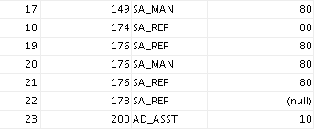
Using the UNION ALL Operator
Display the current and previous departments of all employees.
SELECT employee_id, job_id, department_id FROM employees
UNION ALL
SELECT employee_id, job_id, department_id FROM job_history
ORDER BY employee_id;
…
…

Slide 14
Lesson Agenda
Set Operators: Types and guidelines
Tables used in this lesson
UNION and UNION ALL operator
INTERSECT operator
MINUS operator
Matching the SELECT statements
Using ORDER BY clause in set operations

Slide 15
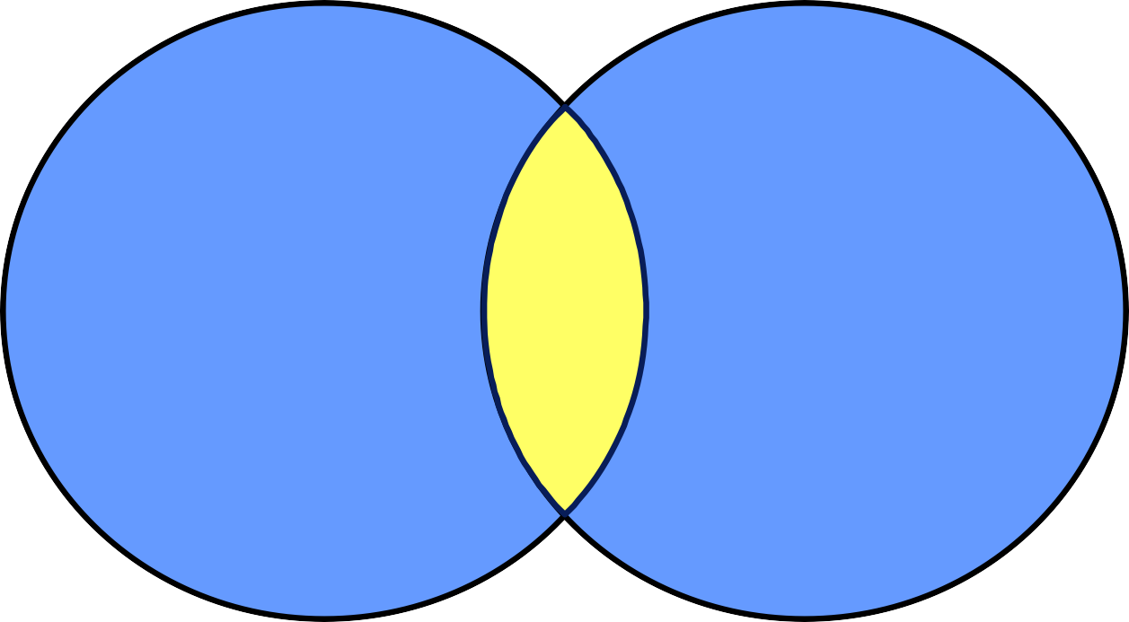
INTERSECT Operator
A
B
The INTERSECT operator returns rows that are common to both queries.

Slide 16

Using the INTERSECT Operator
Display the employee IDs and job IDs of those employees who currently have a job title that is the same as their previous one (that is, they changed jobs but have now gone back to doing the same job they did previously).
SELECT employee_id, job_id FROM employees
INTERSECT
SELECT employee_id, job_id FROM job_history;

Slide 17
Lesson Agenda
Set Operators: Types and guidelines
Tables used in this lesson
UNION and UNION ALL operator
INTERSECT operator
MINUS operator
Matching the SELECT statements
Using the ORDER BY clause in set operations

Slide 18

MINUS Operator
A
B
The MINUS operator returns all the distinct rows selected by the first query, but not present in the second query result set.

Slide 19


Using the MINUS Operator
Display the employee IDs of those employees who have not changed their jobs even once.
SELECT employee_id FROM employees MINUS
SELECT employee_id FROM job_history;
…

Slide 20
Lesson Agenda
Set Operators: Types and guidelines
Tables used in this lesson
UNION and UNION ALL operator
INTERSECT operator
MINUS operator
Matching the SELECT statements
Using ORDER BY clause in set operations

Slide 21
Matching the SELECT Statements
Using the UNION operator, display the location ID, department name, and the state where it is located.
You must match the data type (using the TO_CHAR function or any other conversion functions) when columns do not exist in one or the other table.
SELECT location_id, department_name "Department", TO_CHAR(NULL) "Warehouse location"
FROM departments UNION
SELECT location_id, TO_CHAR(NULL) "Department",
state_province FROM locations;

Slide 22
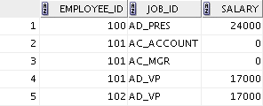

Matching the SELECT Statement: Example
Using the UNION operator, display the employee ID, job ID, and salary of all employees.
SELECT FROM | employee_id, employees | job_id,salary
UNION
SELECT | employee_id, | job_id,0
FROM | job_history;
…

Slide 23
Lesson Agenda
Set Operators: Types and guidelines
Tables used in this lesson
UNION and UNION ALL operator
INTERSECT operator
MINUS operator
Matching the SELECT statements
Using the ORDER BY clause in set operations

Slide 24
Using the ORDER BY Clause in Set Operations
The ORDER BY clause can appear only once at the end of the compound query.
Component queries cannot have individual ORDER BY
clauses.
The ORDER BY clause recognizes only the columns of the first SELECT query.
By default, the first column of the first SELECT query is used to sort the output in an ascending order.

Slide 25
Quiz
Identify the set operator guidelines.
The expressions in the SELECT lists must match in number.
Parentheses may not be used to alter the sequence of execution.
The data type of each column in the second query must match the data type of its corresponding column in the first query.
The ORDER BY clause can be used only once in a compound query, unless a UNION ALL operator is used.

Slide 26
Summary
In this lesson, you should have learned how to use:
UNION to return all distinct rows
UNION ALL to return all rows, including duplicates
INTERSECT to return all rows that are shared by both queries
MINUS to return all distinct rows that are selected by the first query, but not by the second
ORDER BY only at the very end of the statement

Slide 27
Practice 8: Overview
In this practice, you create reports by using:
The UNION operator
The INTERSECT operator
The MINUS operator

